Slide 1



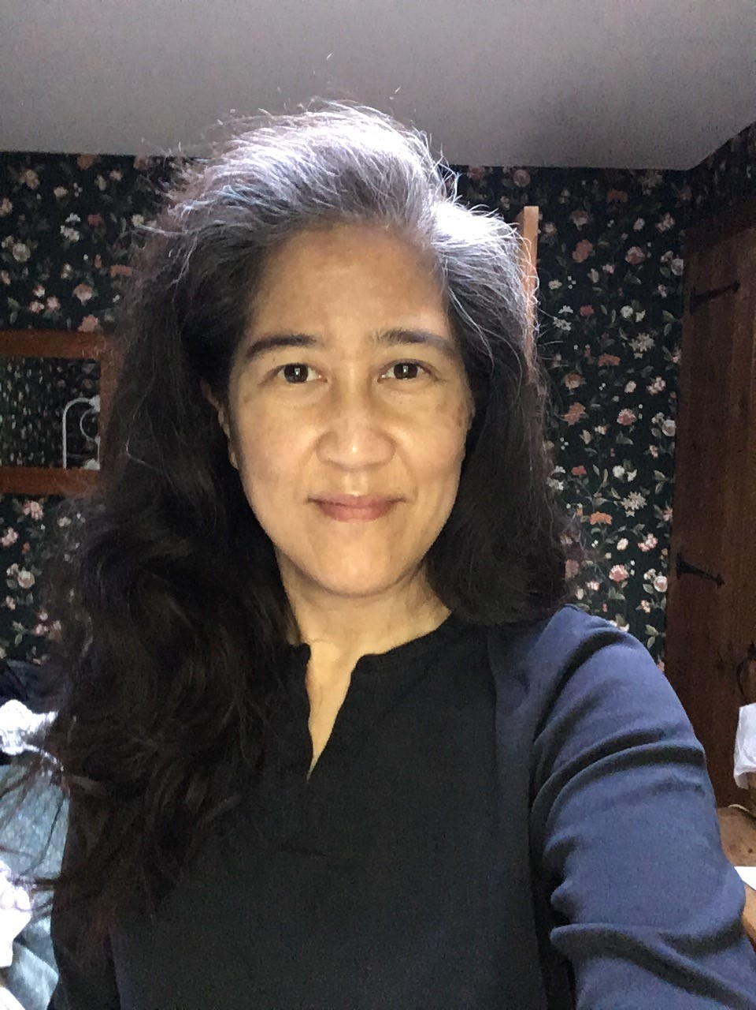
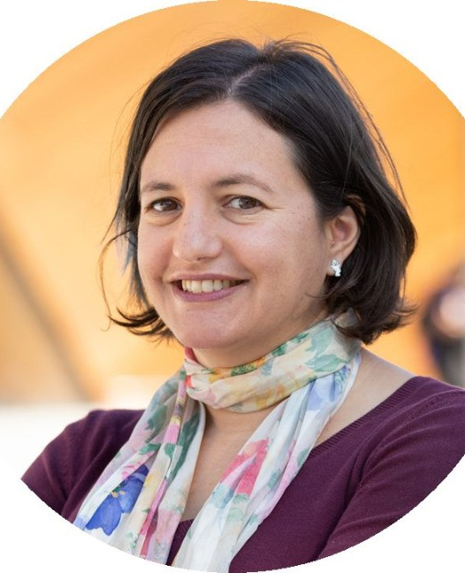
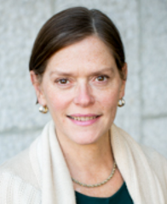
Counting Constellations, Not the Whole Sky:
Diversity Assessment at a Large
University Library
Noa Kaumeheiwa
Law Library
Karen Kohn
University Libraries
Jenny Pierce (in absentia)
Ginsburg Health Sciences Library
Notes:
NK (with Karen chime in)

Slide 2

Collection Assessment for Diversity
Walters, William H. “Assessing Diversity in Academic Library Book Collections: Diversity Audit Principles and Methods.” Open Information Science 7, no. 1 (2023): 20220148.
“evaluate whether the library collection provides adequate support for particular academic departments, degree programs, faculty, and student groups
“facilitate the effective allocation of resources by identifying areas in which the collection is weaker
“help build greater knowledge of the collection among librarians ... to improve their effectiveness as selectors or ... refine ... selection criteria
“pinpoint the areas in which greater effort is needed[, by] revealing the percentage of titles that are associated with particular underrepresented or marginalized groups”
Notes:
NK

Slide 3
Diversity Assessment at Larger Libraries
Jahnke, Lori, Kyle Tanaka, & Christopher Palazzolo. “Ideology, Policy, and Practice: Structural Barriers to Collections Diversity in Research and College Libraries.” College & Research Libraries 83, no. 2 (2022), 166.
“In 2010, Matthew Ciszek and Courtney Young noted that very little had been written about large-scale diversity collection assessment, and seven years later Jenny Semenza and colleagues came to a similar conclusion.”
Walters says the most appropriate method for large libraries is catalog searching – that is, counting the number of results for various targeted searches – and says that coding projects, which involve closely reviewing specific titles, are not appropriate.
Walters, “Assessing Diversity in Academic Library Book Collections,” 2023.
Notes:
NK

Slide 4

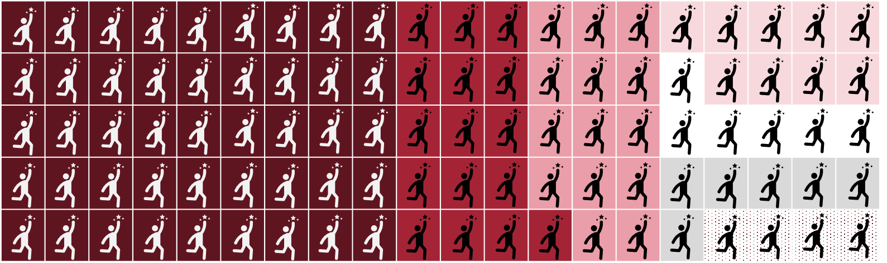
Temple Students
Enrollment by race/ethnicity, 2023-2024
Total enrollment: 30,530
White, non-Hispanic 45%
Asian 14%
Hispanic, Latinx 9%
African
American 16%
International 6%
Unknown 6%
Two or more races 4%
https://ira.temple.edu/sites/ira/files/At-A-Glance-2023-2024.pdf
Notes:
NK : https://ira.temple.edu/sites/ira/files/At-A-Glance-2023-2024.pdf

Slide 5
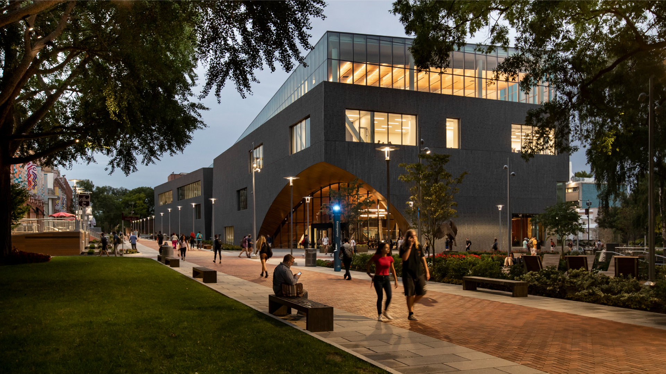
Temple University Libraries
2.5 million physical items
1.8 million books in general collections
3 million ebooks
982 databases
Notes:
NK

Slide 6
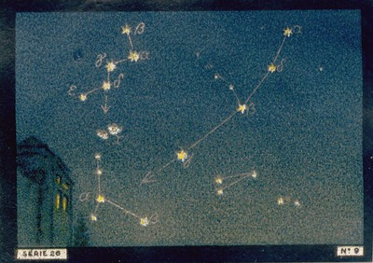
Our Solution
Distinct projects focused on specific areas of the collection
https://www.flickr.com/photos/taffeta/8936863300
Notes:
NK

Slide 7
Who’s Who
Volunteer auditors
4 librarians with liaison responsibilities expressed interest
DEI in Collections Committee
  3 members, various organizational roles
  Have partnered with other library staff on a project basis
Volunteer auditors
  4 librarians with liaison responsibilities expressed interest
DEI in Collections Committee
3 members, various organizational roles
Have partnered with other library staff on a project basis
Notes:
NK

Slide 8
Informational Meeting
Handout discussing motivations and methods
Asked librarians to email us afterwards to confirm participation
Notes:
KK

Slide 9
Motivation Influences Method
Support Curriculum
Start with course descriptions to determine scope
Focus on subject matter
Notes:
KK
One of the first things on our handout that we shared at the meeting was different motivations and how they would influence method. These are motivations for *having* diversity in the collection. Noa already shared motivations for *measuring*.
Some examples of courses at Temple - EDUC 4441. Discourse Practices in Diverse Communities, AAAS 1271. Urban Black Politics, AAAS 2058. African American Music, LAS 2101. Latin America through Film and Fiction, LGBT 2406. LGBTQ Social Movements

Slide 10
Let Students See Themselves Reflected
Motivation Influences Method
  Scope could be an entire subject area, or a subset, e.g. American history in the later 20th century
  Could look at either author identities or subject matter
  Need to decide which identity categories to focus on – race, gender, disability status, LGBTQ identities
  Look at the composition of student body
Notes:
KK

Slide 11
Help Students Learn About Different People
Motivation Influences Method
  If preparing for a service profession, there may be specific populations especially important to learn about. This could connect back to the curriculum.
  Most likely focus on subject matter
  Would need to decide which identity categories to focus on – race, gender, disability status, LGBTQ identities
  Composition of the university not as relevant. Possibly no clear goal of which populations should be represented and in what proportions. The assessment would be exploratory.
Notes:
KK
We have a social work class on racism, Education class related to teaching English language learners.
But it's also an important part of general education to learn about people who are different from you.
Exploratory can also be valuable, as you'll see when we show some of our findings.

Slide 12
Assessment Methods
List-Checking
Find or create a list of recommended books and search the catalog to see if the library has them
Metadata Searching
Figure out all the call numbers or subject terms related to various populations, search the catalog to see how many titles there are.
Diversity Coding
Assign codes to books from a sample, based on information found in the catalog or the book.
Notes:
KK

Slide 13
List-Checking
Assessment Methods
Could use a list of award-winners
The result is calculation of the percentage of the list held by the library
After doing the audit, an action step would be to order the books the library doesn’t have.
Example: Monroe-Gulick, Amalia & Sara E. Morris (2023) “Diversity in Monographs: Selectors, Acquisitions, Publishers, and Vendors,” Collection Management, 48:3, 210-233.
Notes:
KK
In addition to defining the methods, our handout provided considerations for each method and an example, these are on the slides as well

Slide 14
Metadata Searching
Assessment Methods
The result is a number. It won’t show if the books are positive and accurate portrayals of the groups in question.
Can limit a search by call number range for a discipline and then search for subject headings within that range.
It’s hard to be intersectional using this method but may be possible.
Example:
Proctor, Julia, "Representation in the Collection: Assessing Coverage of LGBTQ Content in an Academic Library Collection." Collection Management 45, no. 3 (2020): 223-234.
Notes:
KK
This can be done in a reporting tool, like Alma Analytics or through searching the OPAC.
Lets you in theory look at whole collection at once, but in a shallow way.
We included this second point as a suggestion because we thought our auditors might want to look only at history books or only at social work books.
You'd need a string of terms related to one identity, like race, and then another string related to another identity, e.g. gender or sexuality, then combine the two strings with AND.

Slide 15
Diversity Coding
Assessment Methods
Relies on sampling.
The result is a percentage of items in the sample representing each aspect of identity. This can be compared to the student body.
This is the only one of these methods that allows for evaluating author identity. Coding for subject matter is also possible.
Ethically coding an author’s identity is tricky!
This method allows for intersectional analysis.
Most labor-intensive.
Example:
Emerson, María Evelia & Lauryn Grace Lehman, "Who Are We Missing? Conducting a Diversity Audit in a Liberal Arts College Library." Journal of Academic Librarianship 48 (2022): 102517.
Notes:
KK
The most flexible method, as you create your own categories. It lets you look more closely at books and also lets you make observations about traits that you hadn't initially thought to include in your analysis. But because it requires looking at individual books, you have to sample!
Our auditors were uncomfortable with the thought of categorizing authors by identity. I was prepared to give some guidance on that, but no one chose that approach.

Slide 16
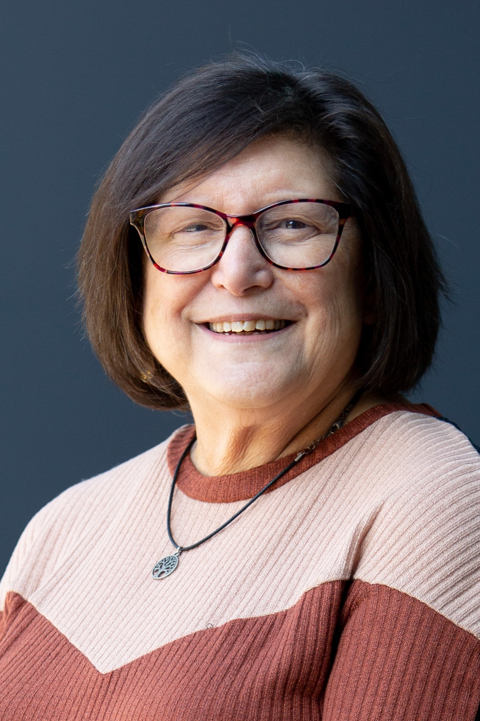
Three Projects
Indigenous People
Andrea Goldstein
Librarian
Ambler Branch Library
Focus: Indigenous People
Method: Catalog search by subject headings, followed by analysis of results based on call number range, location, and year
Notes:
NK Three people decided to do projects, 1 did not.
We can admit that when they came back to us with project ideas, none of them exactly followed the model of identifying a motivation and then using that to choose a method. They just told us what they'd decided to do. In two cases it was related to their selection responsibilities, but Andrea's wasn't.
Also note that they were very uncomfortable with the idea of looking at author identities, mostly because of the uncertainty involved. The Emerson and Lehman article cited on the previous slide does this in a thoughtful way, and we had told the selectors that we'd all work together to figure out guidelines, but none of them chose to pursue this as a focus.

Slide 17
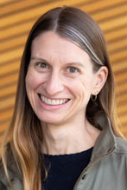
World War II
Three Projects
Rebecca Lloyd
Learning & Research Services,
Librarian for History, Spanish & Portuguese
Focus: Books about World War II, looking at various facets of diversity, such as race, gender, geography, and publisher type
Method: Code catalog record information in a random sample of the collection
Notes:
NK Three people decided to do projects, 1 did not.
We can admit that when they came back to us with project ideas, none of them exactly followed the model of identifying a motivation and then using that to choose a method. They just told us what they'd decided to do. In two cases it was related to their selection responsibilities, but Andrea's wasn't.
Also note that they were very uncomfortable with the idea of looking at author identities, mostly because of the uncertainty involved. The Emerson and Lehman article cited on the previous slide does this in a thoughtful way, and we had told the selectors that we'd all work together to figure out guidelines, but none of them chose to pursue this as a focus.

Slide 18
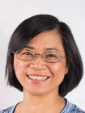
Social Work with Asian People
Three Projects
Van Tran
Learning & Research Services,
Public Health and Social Sciences Librarian
Focus: Social Work with Asian People
Method: Catalog search by subject headings with counts of specific Asian populations
Notes:
NK Three people decided to do projects, 1 did not.
We can admit that when they came back to us with project ideas, none of them exactly followed the model of identifying a motivation and then using that to choose a method. They just told us what they'd decided to do. In two cases it was related to their selection responsibilities, but Andrea's wasn't.
Also note that they were very uncomfortable with the idea of looking at author identities, mostly because of the uncertainty involved. The Emerson and Lehman article cited on the previous slide does this in a thoughtful way, and we had told the selectors that we'd all work together to figure out guidelines, but none of them chose to pursue this as a focus.

Slide 19
Expectations
You may encounter some offensive terms, particularly in metadata.
The data is not going to be perfect.
Notes:
NK

Slide 20
Dividing Responsibilities
DEI Committee | Auditors
Handout describing methods, with examples from literature | Chose a method and focus
Reports from Alma Analytics | Lists of relevant subject headings and call numbers
Training in Excel | Coding (1 project)
Create tables in Excel | Numerical analysis of findings
Notes:
NK

Slide 21
Workflow
Full cohort met every 5-8 weeks with committee
Shared project folders hold data and notes
Individual support between meetings
Notes:
NK

Slide 22
Questions that Arose
Do we want to include ebooks and print books?
Can we include journals?
Should we include government documents?
How many books to code?
What characteristics to code for?
How much searching will we do to determine what a book is about?
Notes:
NK

Slide 23
Some Findings
Indigenous People
LC Class | Print Books | Ebooks
E | 3527 | 4526
GN | 253 | 437
J | 2560 | 1
KF | 73 | 846
Unknown | 1002 | 3521
Total | 9107 | 11140
Notes:
KK
This started out as a metadata search project, but then we sliced and diced the results.
Both print and e largest group was in history. I included some of the other sections that stood out. I expected more in anthropology, but these numbers were fairly low.
Andrea did not find books related to plants, which would be in the Qs, but these numbers were very low, like 20 in each format.
Large unknowns in both formats.

Slide 24
Subject Headings found in E
Indians of North America—Religion
Indians of North America—Food
Indians of North America — Funeral customs and rites
Indian arts — North America
Some Findings
Indigenous People
Notes:
KK
Here's where it got more interesting. Since the E section had the largest number of books, Andrea looked at those more closely and noticed a lot of books that didn't seem to be history (examples on slide), she brought this to the group and we felt that clustering all books on North American Indigenous people in E enforces the idea of Native Americans as part of the past. We’re all new to thinking about this, so we checked with our Head of Metadata, who has done research on this, and --

Slide 25
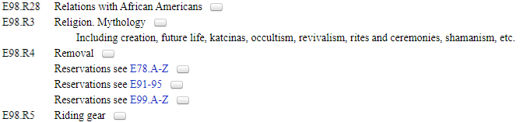
Indigenous People
Some Findings
Notes:
KK -- we learned that there is no classification for North American Indigenous religion in the Bs, with religion. So apparently according to LC indigenous religions are not American, and are part of history. The classification is in "Indians of North American – Other Topics, A-Z." This sends a message not only about Native Americans as part of the past but about the legitimacy and significance of indigenous religions. This is something others have researched, it's not new, and religion isn't the only classification that is a problem, but it is something we learned about through doing this project.

Slide 26
Some Findings
World War II
Location (Geographic setting/focus) | Gender (GN) | Religion (RL) | Non-White (NW) | Sexuality (SX) | Holocaust | None | Total
Africa | 0.0% | 0.0% | 0.0% | 0.0% | 0.0% | 1.2% | 1.2%
Americas | 0.0% | 0.4% | 0.4% | 0.4% | 0.4% | 2.0% | 3.6%
Asia/Pacific | 0.8% | 0.0% | 6.0% | 0.4% | 0.0% | 7.6% | 14.4%
Australia | 0.4% | 0.0% | 0.0% | 0.4% | 0.0% | 0.0% | 0.4%
Eastern Europe | 0.8% | 7.6% | 0.4% | 0.0% | 8.0% | 11.6% | 22.4%
Global | 0.0% | 2.0% | 0.0% | 0.4% | 2.4% | 6.0% | 8.8%
Middle East | 0.0% | 0.4% | 0.0% | 0.0% | 0.8% | 0.8% | 1.6%
US | 1.2% | 0.4% | 3.2% | 0.0% | 1.2% | 16.0% | 21.6%
Western Europe | 4.4% | 6.0% | 1.2% | 0.0% | 8.8% | 34.4% | 48.4%
Total | 5.6% | 12.8% | 10.0% | 1.2% | 16.4% | 66.0% | 250
Notes:
KK
Mostly not surprising – a lot about Western Europe, followed by Eastern Europe and the U.S., then Asia. (look at totals on the right) Very little about gender, religion, or any of the categories totaled at the bottom.
Another observation she made is that she hadn't looked at publication date is a consideration – books published right after WWII have a different perspective, more like primary sources. Even though this assessment method lets you look at many aspects of a book, there are even more factors that would affect how it does or doesn't contribute to diversity in the collection. It made her think a lot about what goes into creating a balanced or useful collection.

Slide 27
Social Work with Asian People
Some Findings
 | Title | Description | Subjects | Total
East Asia | 165 (1.01%) | 545 (3.34%) | 168 (1.03%) | 588 (3.6%)
Southeast Asia | 58 (0.36%) | 267 (1.64%) | 74 (0.25%) | 280 (1.72%)
South Asia | 63 (0.39%) | 287 (1.76%) | 36 (0.22%) | 280 (1.72%)
Central Asia | 3 (0.02%) | 12 (0.07%) | 6 (0.04%) | 17 (0.10%)
All Groups | 266 (1.63%) | 859 (5.26%) | 258 (1.58%) | 959 (5.88%)
Notes:
KK

Slide 28
Possible Action Steps
Propose a heading: Social work with Asian people
Weed military publishers
Seek more books about women and people of color in the U.S. in World War II
No clear action step related to North American Indigenous people
Notes:
KK
Rebecca has been thinking about weeding, but because we are a research institution anything could potentially be relevant to someone's research. There seems to be a conflict between what we want to have available for possible research and what we want to make readily available for undergraduates who might not be the best judges of sources. She's still thinking about what to do.
Rebecca asks, Could we scout out more diverse works about WWII? Because this is so narrow and specific, it would be harder to identify an ongoing strategy for the future, but she might be able to find individual books for one-time purchases.
Andrea (indigenous people) in was unsure about action steps, partly because the biggest issue she discovered was the LC classification. This leads to our reflections

Slide 29
Our Reflections
Think about what changes you’ll be able to make as outcomes of the audit and who has the authority to make them.
  Does the assessment need to be tied to a person’s selection responsibilities?
Keeping it open-ended allowed for more learning
Be specific with deadlines and schedule regular meetings.
Preparing your data will probably take longer than analyzing it.
Using common tools allows for more eyes on the data.
It's ok to figure out some pieces as you go.
Notes:
KK
Andrea's lack of action was partly because Indigenous People are not tied to any specific person's selection area.
We didn't choose the projects with action steps in mind, if we had we might've tied the assessment more to selection areas.
No one started from a collection need, started from curiosity.
We did want structure.

Slide 30
Our Reflections
Educating the participants is a valid outcome.
  Cohort model supported learning.
  Participants brought and shared different skillsets, knowledge, and confidence.
  Participants were all interested in learning more of the technical skills themselves.
  Projects that let you look deeply into a section of the collection will help you think about the collection at large.
Notes:
NK

Slide 31
References
Emerson, María Evelia & Lauryn Grace Lehman, "Who Are We Missing? Conducting a Diversity Audit in a Liberal Arts College Library." Journal of Academic Librarianship 48 (2022): 102517.
Jahnke, Lori, Kyle Tanaka, & Christopher Palazzolo. "Ideology, Policy, and Practice: Structural Barriers to Collections Diversity in Research and College Libraries." College & Research Libraries 83, no. 2 (2022), 166.
Monroe-Gulick, Amalia & Sara E. Morris (2023) "Diversity in Monographs: Selectors, Acquisitions, Publishers, and Vendors." Collection Management, 48:3, 210-233.
Proctor, Julia, "Representation in the Collection: Assessing Coverage of LGBTQ Content in an Academic Library Collection." Collection Management 45, no. 3 (2020): 223-234.
Walters, William H. "Assessing Diversity in Academic Library Book Collections: Diversity Audit Principles and Methods." Open Information Science 7, no. 1 (2023): 20220148.

Slide 32
Community of Practice
Assessing Diversity in Library Collections
Organized by Karen Kohn, Temple University, and Emily Hopkins, University of Georgia
https://LISTSERV.UGA.EDU/scripts/wa-UGA.exe?SUBED1=ASSESSDIVCOL-L
https://www.zotero.org/groups/4633903/dei_assessment/library

Slide 33
Contact
Noa Kaumeheiwa
noa@temple.edu
Karen Kohn
karen.kohn@temple.edu

